Slide 1
Onboarding Training
Closure: Automate an email to the new joiner marking the closure of his/her onboarding training.

Slide 2
Create the new entry in the SharePoint list for the new user

Slide 3
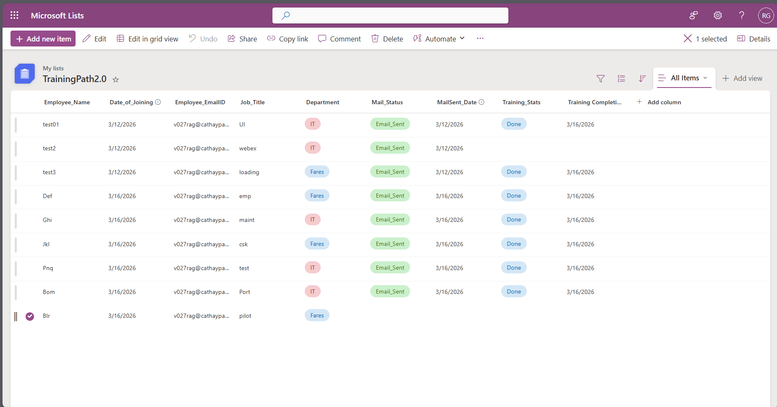

Slide 4
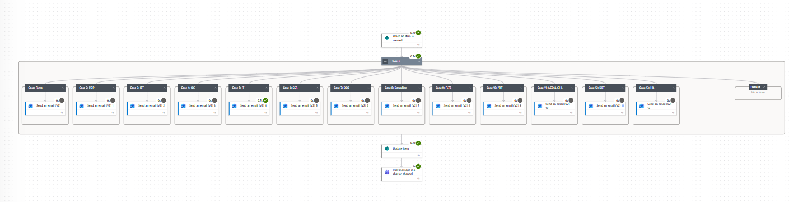

Slide 5
User will receive mail after one day delay after the DOJ

Slide 6
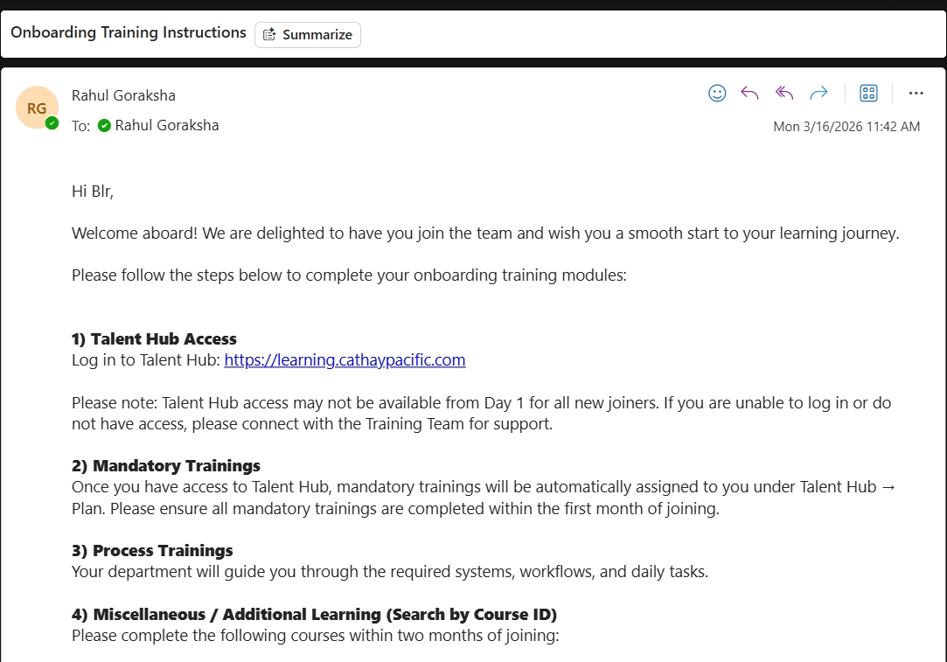

Slide 7
SharePoint will get updated with the Email Sent to the New User about Training Instructions

Slide 8
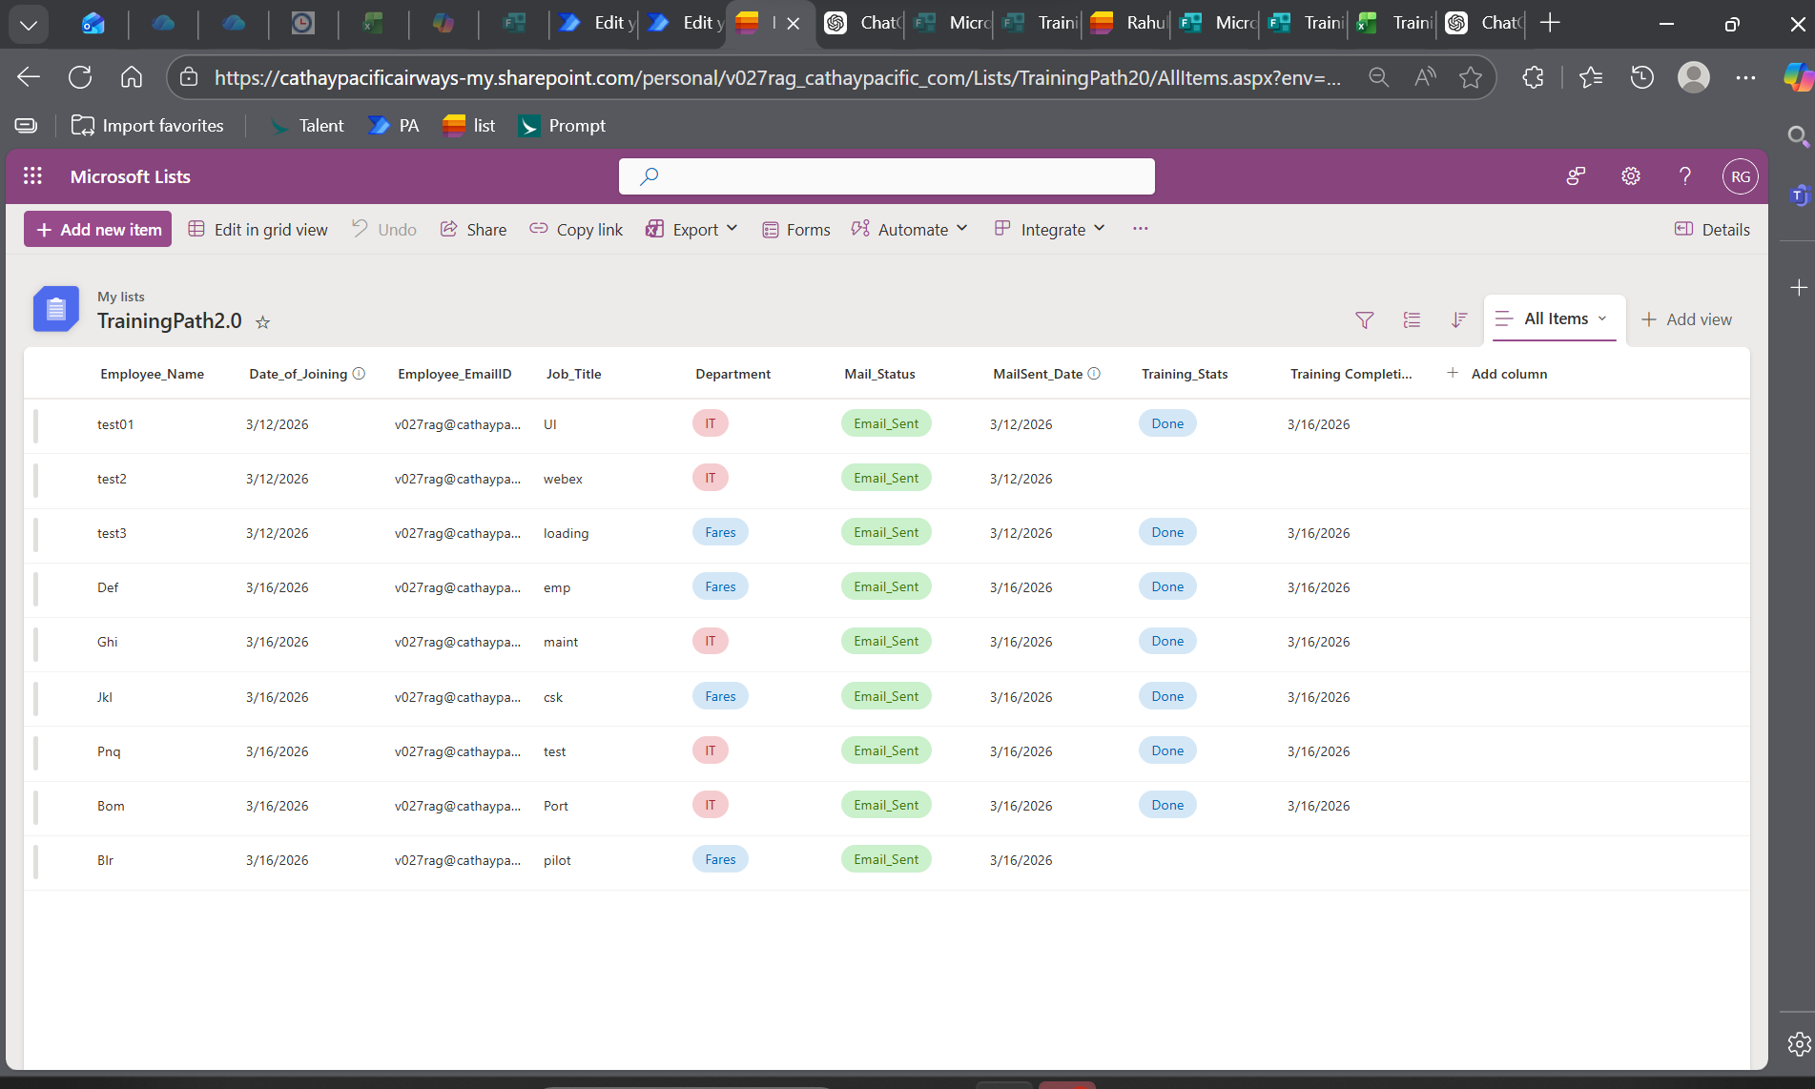

Slide 9
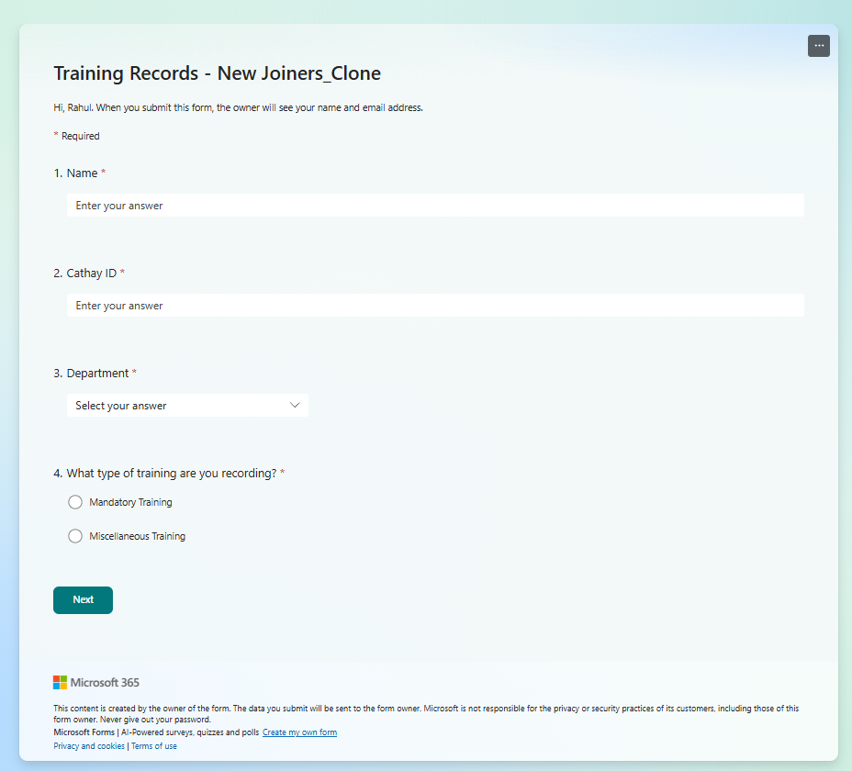

Slide 10
User will tend to fill out the form based on Mandatory or Miscellaneous

Slide 11
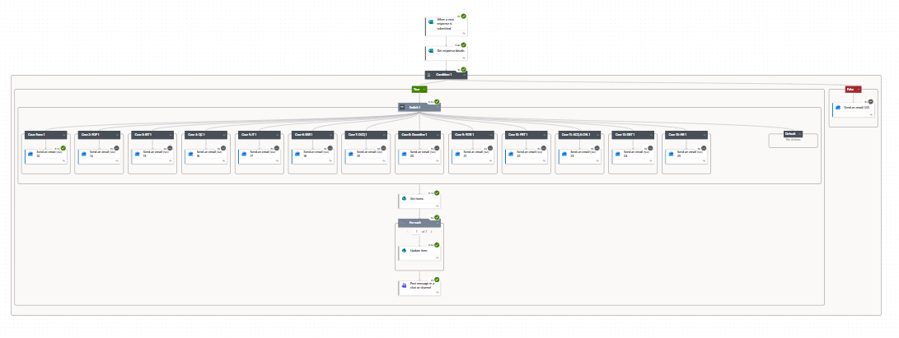

Slide 12
After the 3 days of delay once the user fill out the form it will notify him about the successful completion if chosen the Miscellaneous Training or else send a mail to complete the Miscellaneous Training

Slide 13
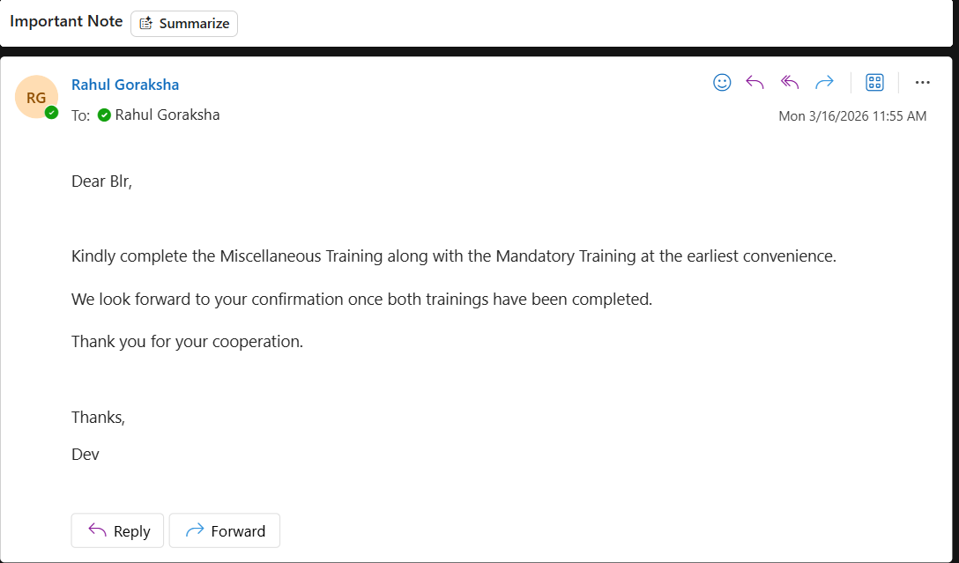

Slide 14
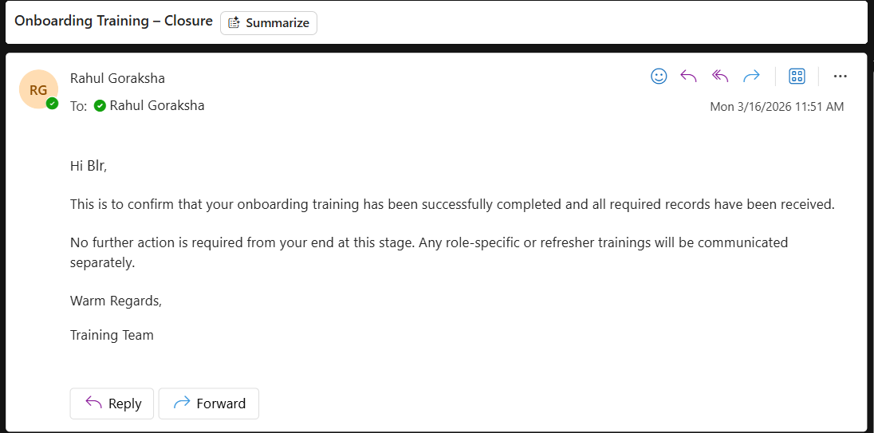

Slide 15
If Successfully completes the Mandatory then the SharePoint list will get finally updated saying the specific user has completed the Training from his end

Slide 16
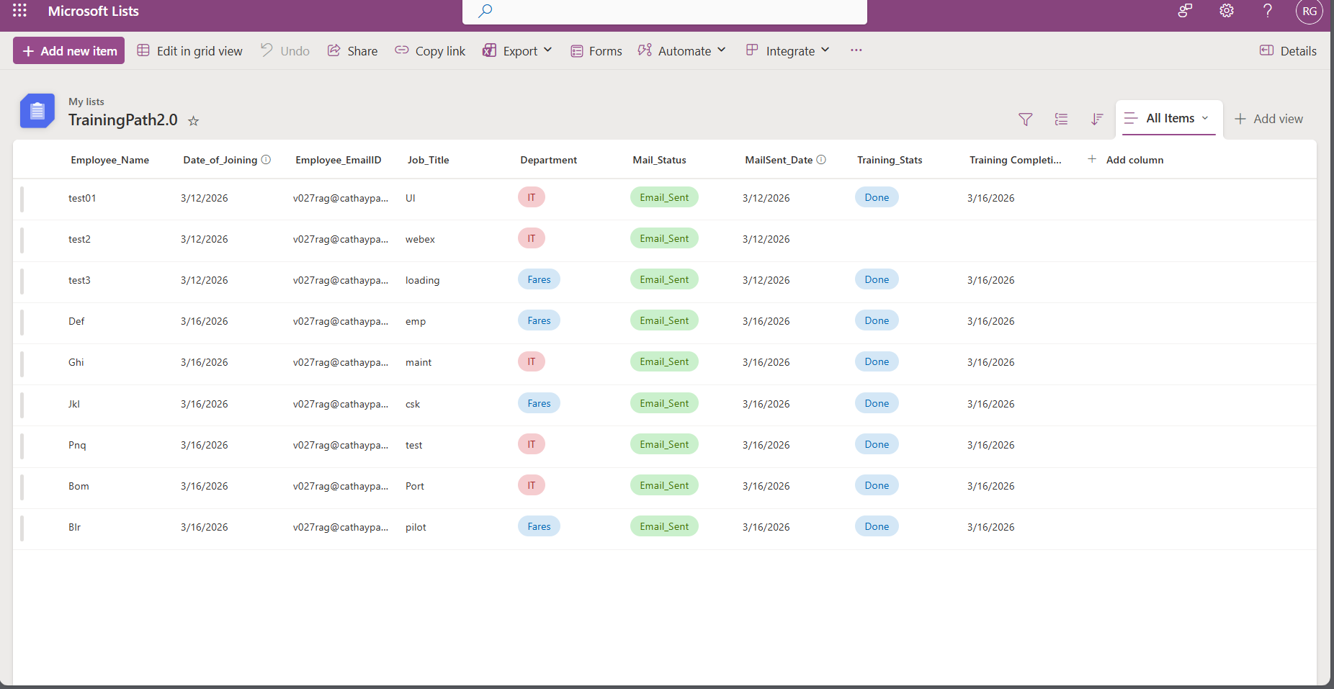

Slide 17
Reg Test:
Robin Joined on 16 March – IT Team – Delay of One Day – Sent Mail
Karl Joined on 17 March – Fares Team – Delay of One Day – Sent Mail

Slide 18
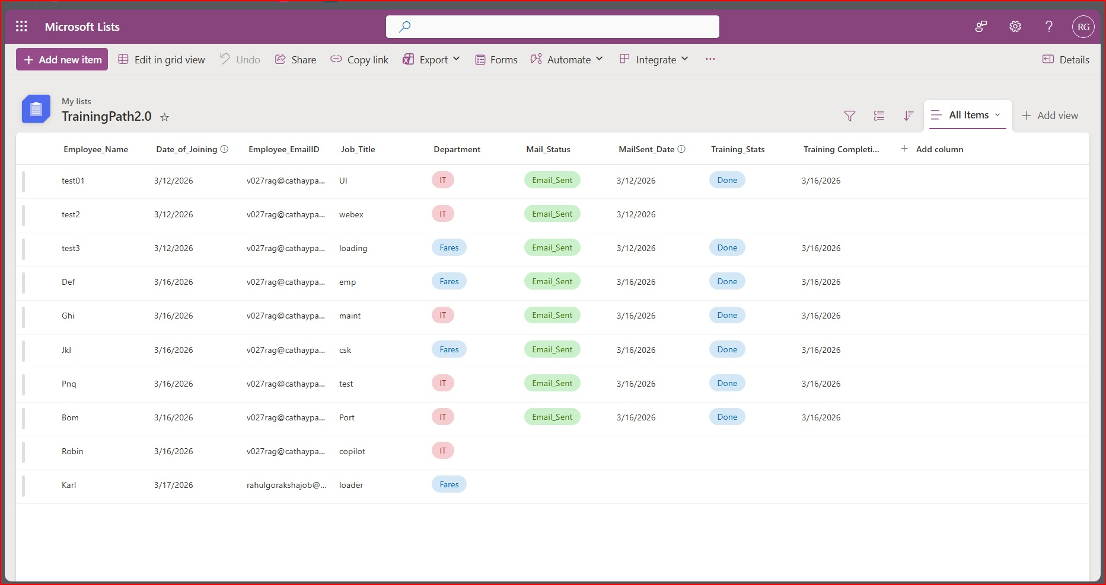

Slide 19
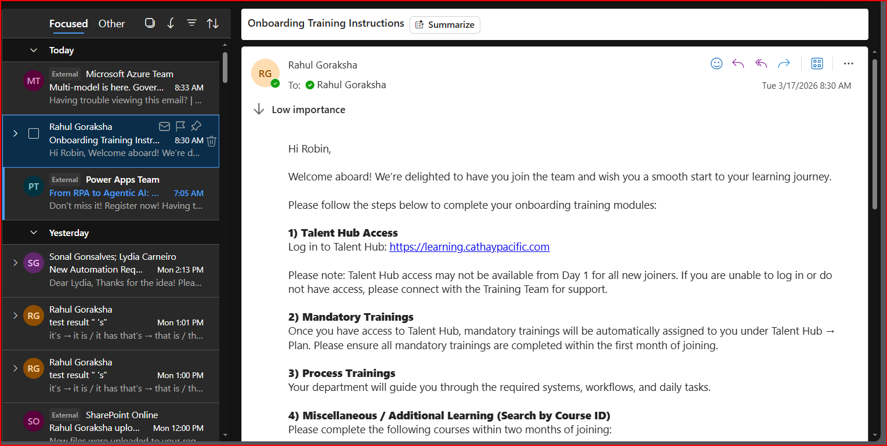

Slide 20
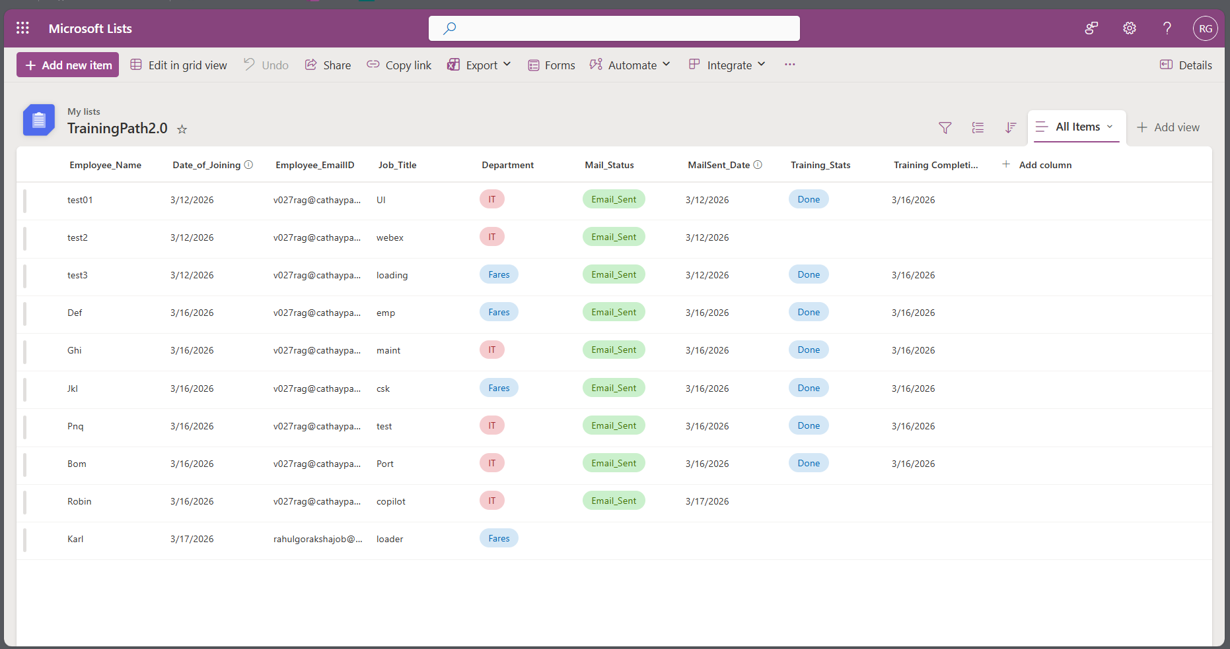

Slide 21
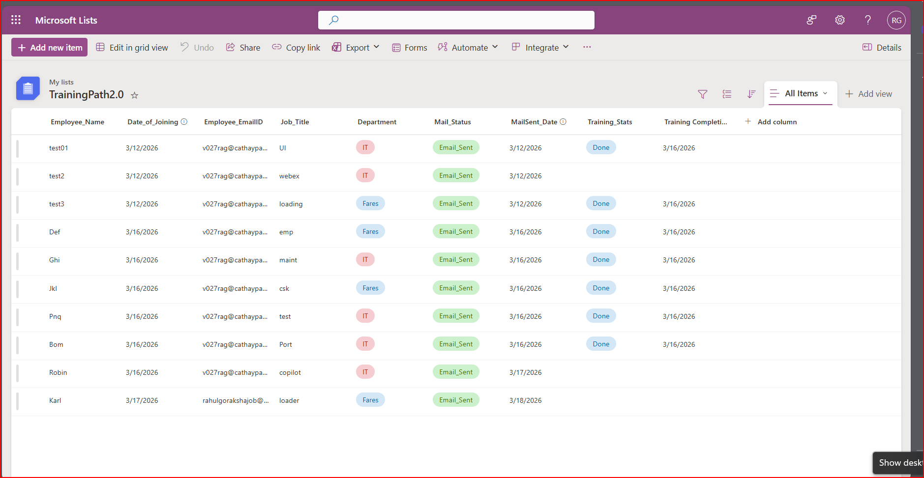

Slide 22
